Slide 1
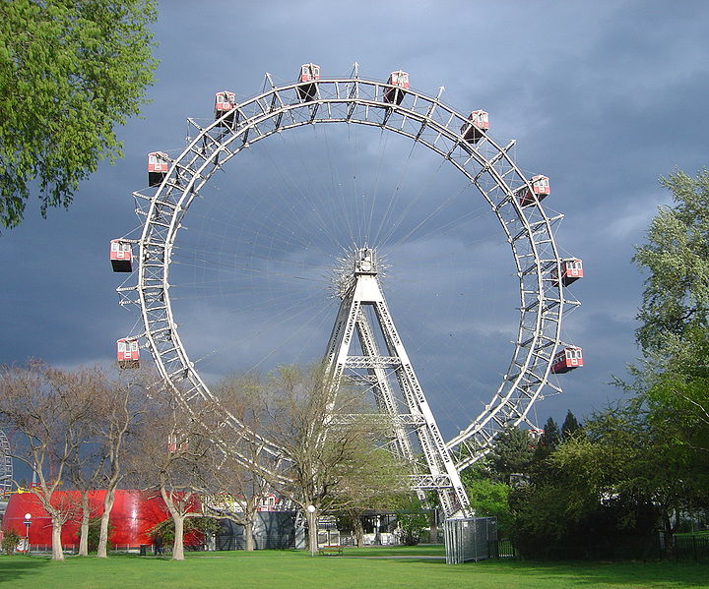
Dynamical Stability of the Intracluster Medium: Buoyancy Instabilities and Nanoastrophysics
Matthew Kunz
Alexander Schekochihin
Schekochihin et al. 2005, ApJ, 410, 139 Kunz et al. 2011, MNRAS, 410, 2446
Kunz & Schekochihin, 2011, MNRAS, nearly submitted

Slide 2
Galaxy Cluster Parameters
Masses ~10^{14–15} M_{sun} (84% DM, 13% ICM, 100s of galaxies)
Sizes ~1 Mpc
Densities n ~10^{–3} to several 10^{–2} cm^{–3}
Temperatures T ~1–10 keV (~10^{7–8} K)
Magnetic fields B ~1–10 G at centre ~0.1–1 G at ~1 Mpc

Slide 3
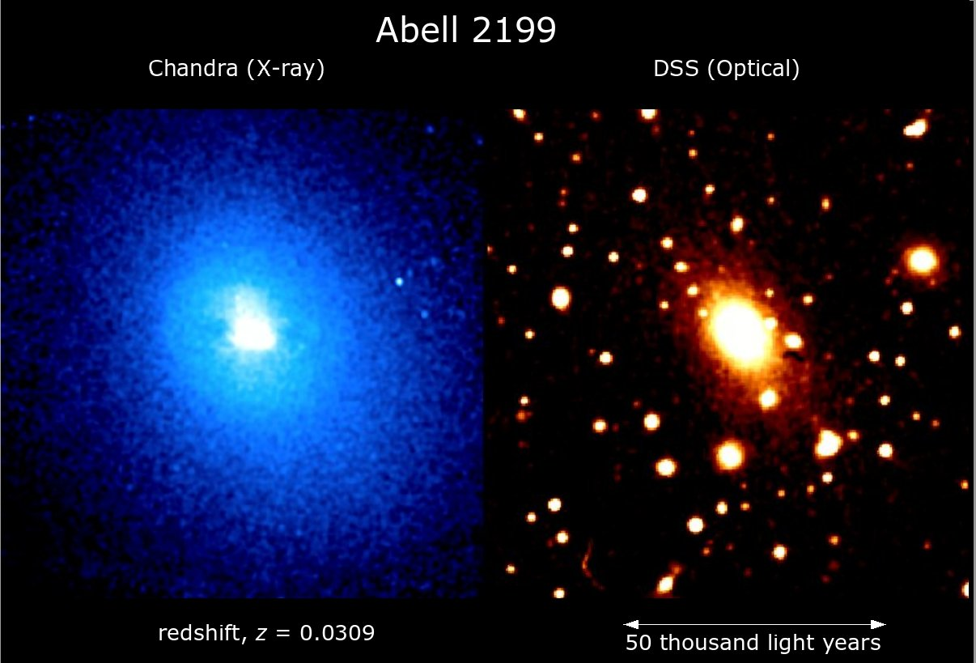

Slide 4
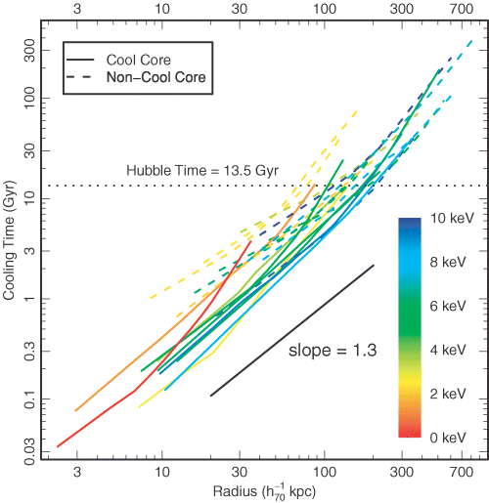
Cooling Time
short cooling time
rapid cooling &
loss of pressure support
cooling flow of ~100–500 M_{sun} yr^{–1}
Sanderson, Ponman & O’Sullivan (2006)

Slide 5
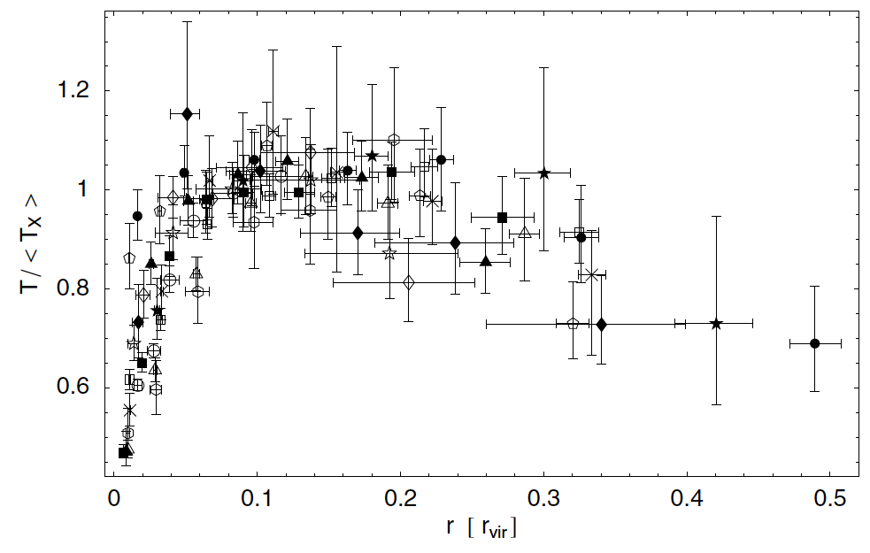
Cool-core clusters
~5–8 keV, ~200 kpc
Piffaretti et al. 2005
~2–3 keV, ~50 kpc

Slide 6
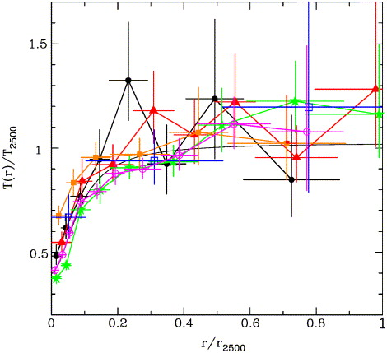
Cool-core clusters
Allen et al. (2001)
What keeps the gas from cooling below ~T_{vir}/3 ?
Piffaretti et al. 2005

Slide 7
Cool-core clusters
Allen et al. (2001)
Possible heating sources:
Heat conduction
AGN feedback
Turbulent heating
Cosmic ray heating
Mergers
What keeps the gas from cooling below ~T_{vir}/3 ?
Piffaretti et al. 2005

Slide 8
First Question: If left on its own (i.e. no AGN input, no mergers, etc.), is the ICM dynamically stable?

Slide 9
ICM Dynamics: A 3-Scale Problem
1 npc ~ 1 trip around the Earth ~ 20,000 miles
(avg. distance driven per year in US is ~15,000 miles)

Slide 10
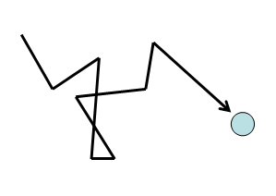
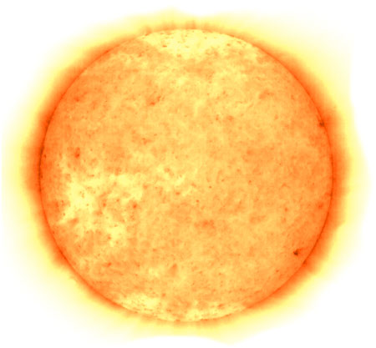
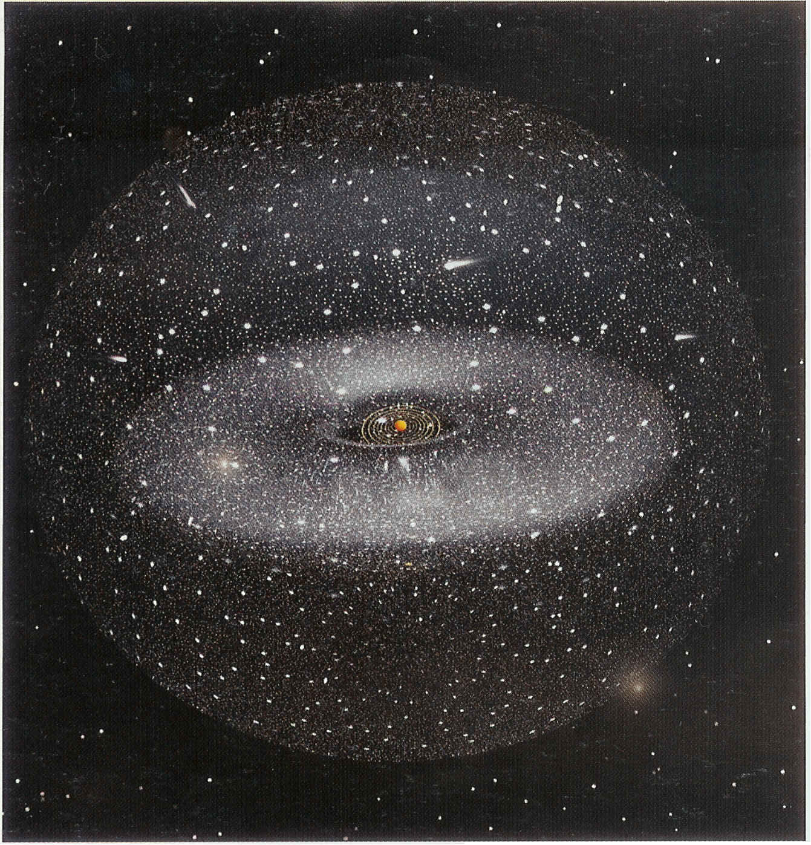
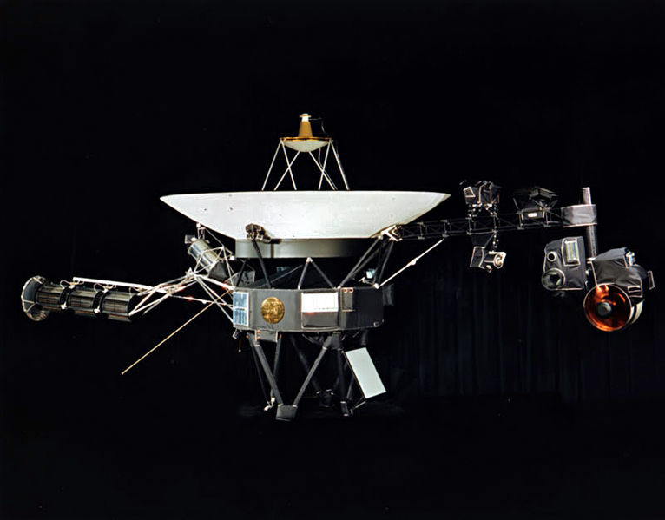
ICM Dynamics: A 3-Scale Problem
Prater Riesenrad
Location of Voyager 1
Oort Cloud

Slide 11
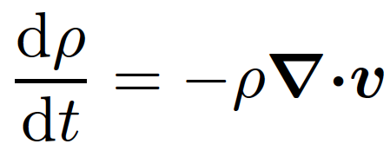
Equations

Slide 12
Standard Linear Analysis
Construct equilibrium state:
Perturb about equilibrium:
Seek solutions of the form:
Test for linear stability:
But first…

Slide 13
Anisotropic Heat Flux: What does it do?
create a local temperature gradient along B, create a heat flux along B

Slide 14
Anisotropic Heat Flux: What does it do?
align B with the background temperature gradient, create a heat flux

Slide 15
Anisotropic Heat Flux: What does it do?
perturb B on which a heat flux is being channeled, increase/decrease that heat flux

Slide 16
Anisotropic Heat Flux: Implications for Stability
field lines become isotherms
destabilizing when stabilizing when
destabilizing when stabilizing when

Slide 17
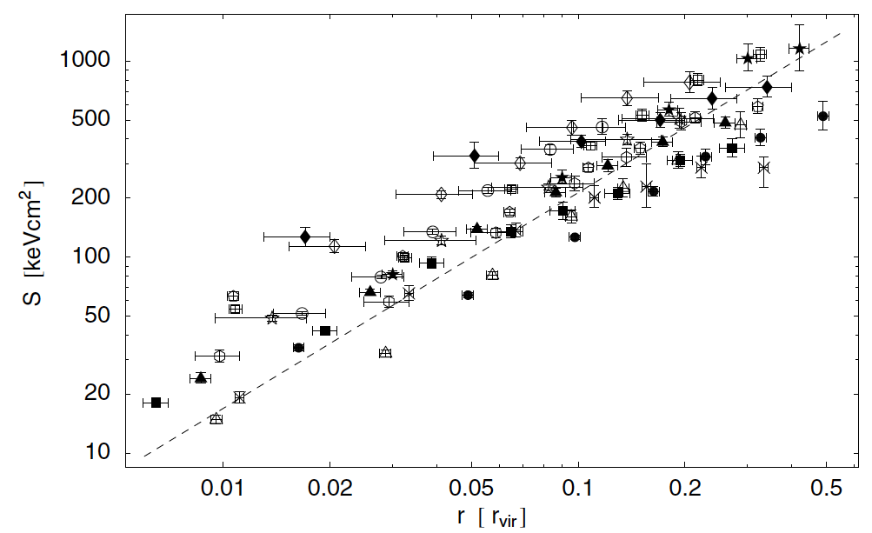
Anisotropic Heat Flux: Implications for Stability
Piffaretti et al. (2005)
Schwarzschild (1958) criterion
Balbus (2000) criterion

Slide 18
: Magnetothermal Instability (Balbus 2000)
destabilised slow mode

Slide 19
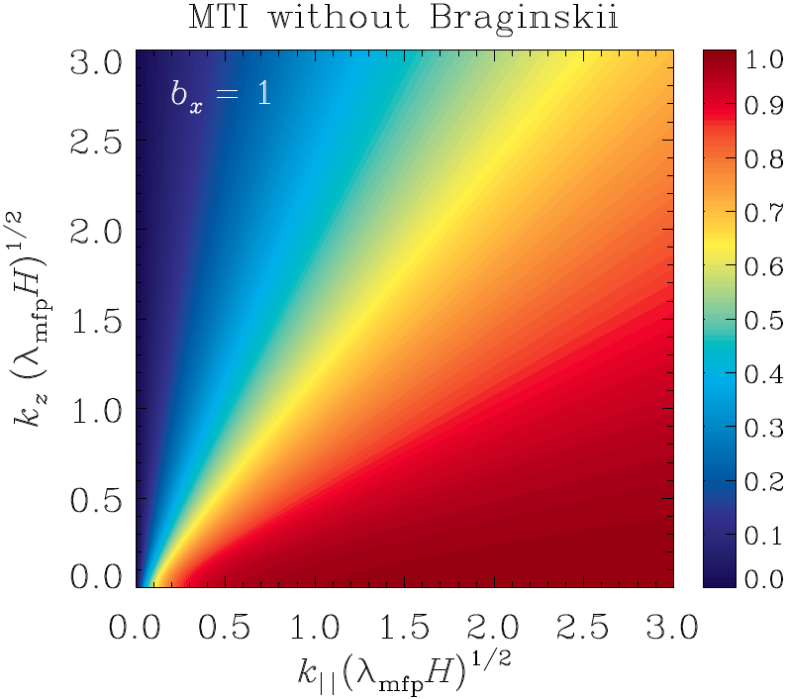
MTI growth rates normalized to maximum value
don’t want field-line convergence/divergence
In general:

Slide 20
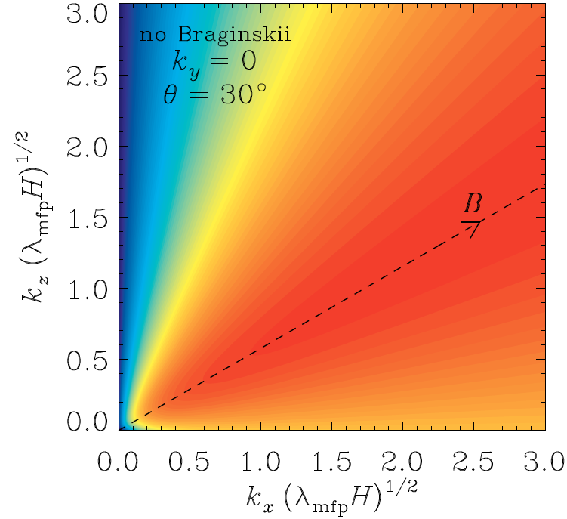
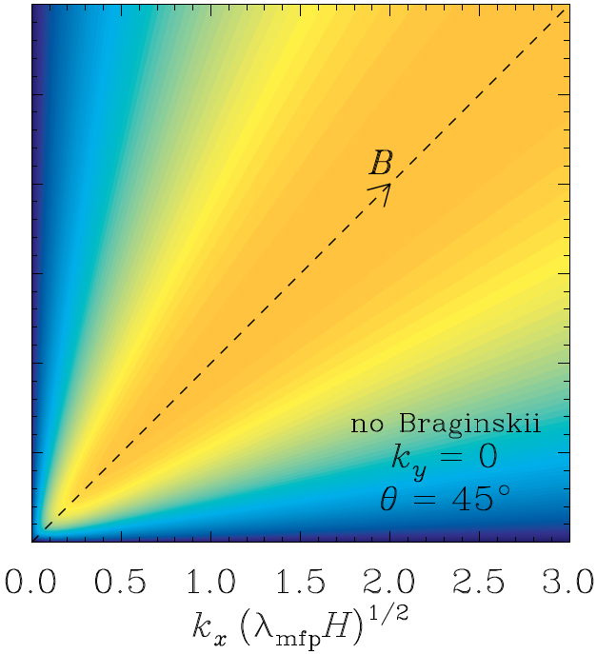
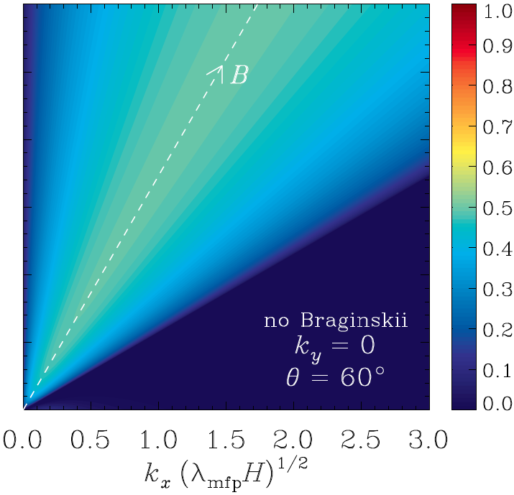
grow fastest
saturates by re-orienting field vertically

Slide 21
HBI
: Heat-flux Buoyancy-Driven Instability (Quataert 2008)
destabilised slow mode

Slide 22
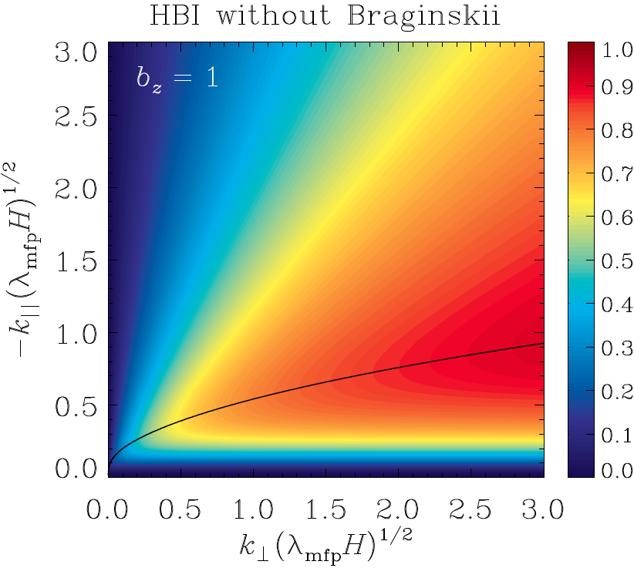
HBI growth rates normalized to maximum value
need maximal field-line convergence/divergence
In general:

Slide 23
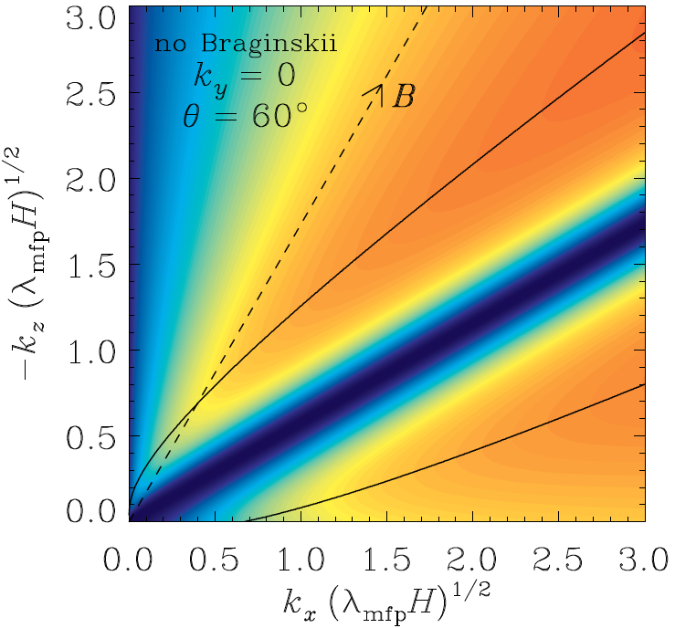
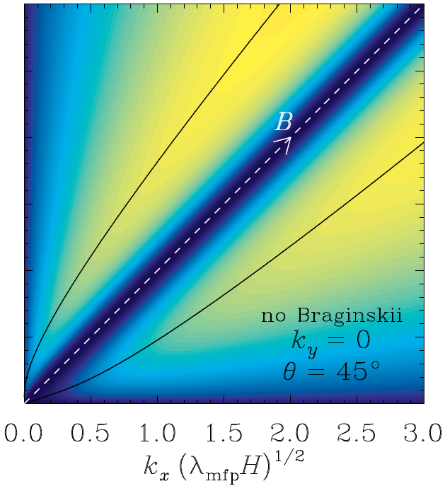
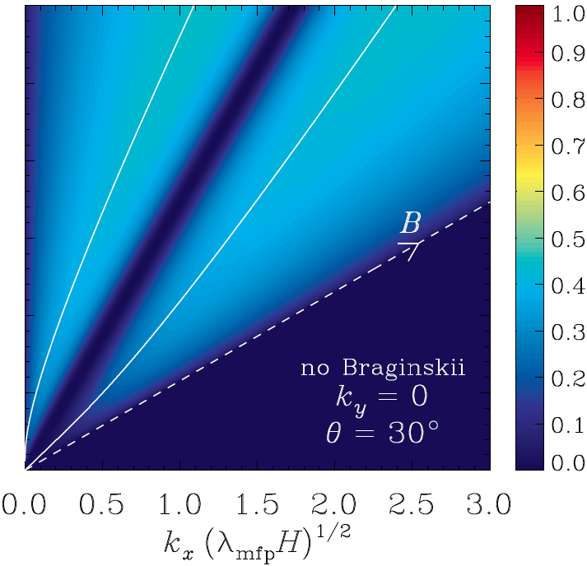
grow fastest
saturates by re-orienting field horizontally to shut off conduction

Slide 24
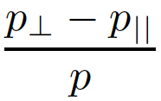
Anisotropic Pressure: What does it do?
First adiabatic invariant conserved provided
holds already for B > 10^{–18} G
Changes in field strength ⇔ pressure anisotropy
~
ii
change in B
drives
anisotropy
anisotropy relaxed
by collisions
when collisions faster than d/dt (remember that mfp << H in ICM)

Slide 25
Anisotropic Pressure: What does it do?
acts as an anisotropic viscosity: “Braginskii viscosity”; targets motions that change the field strength
~
ii
Linearly, this means:
Alfven mode is undamped
Slow mode is damped

Slide 26
Anisotropic Pressure: What does it do?
motions that tap into heat flux are damped
Recall
This hurts the HBI and helps the MTI
First, the HBI…

Slide 27
In fact, the two forces become nearly equal and opposite as i.e., viscosity acts faster than a dynamical timescale for sufficiently large wavenumbers

Slide 28
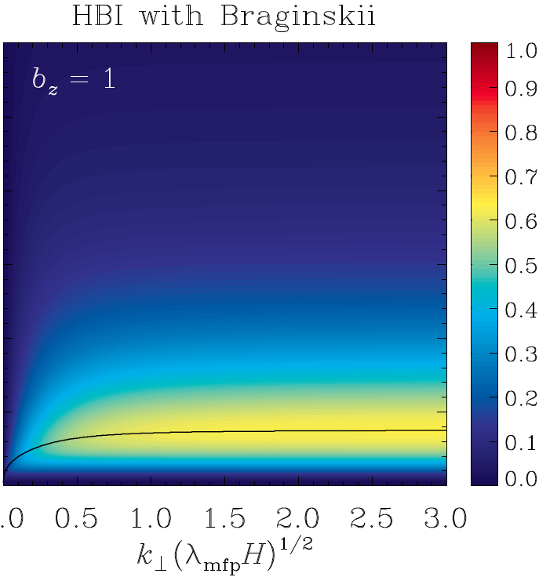
Maximum growth rates are reduced by a factor ~1.5
and now occur at ; in typical cool cores, . These can hardly be considered local modes!

Slide 29
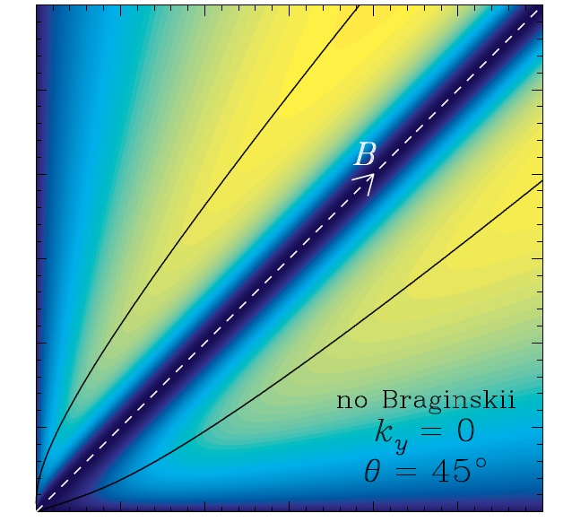
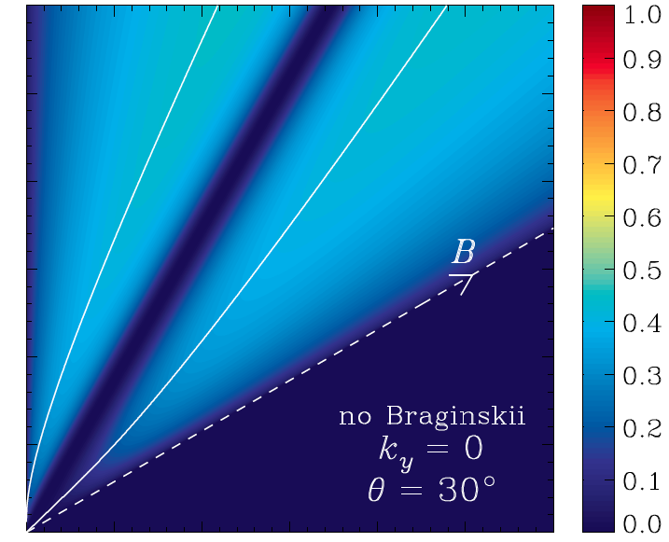
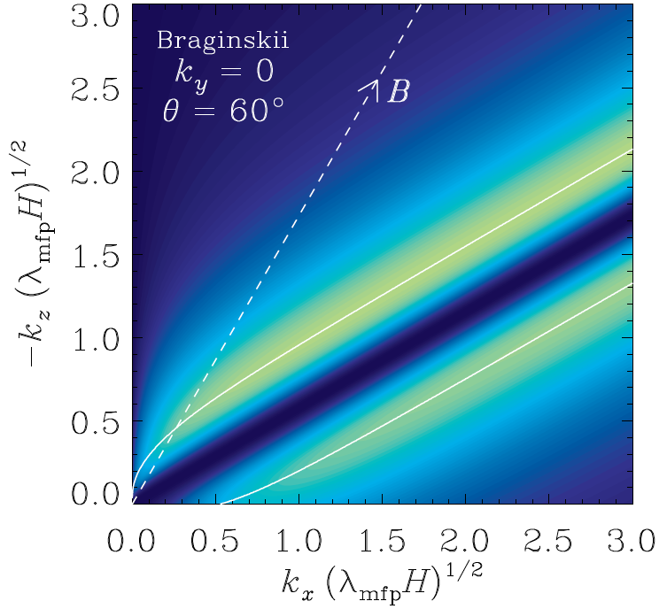
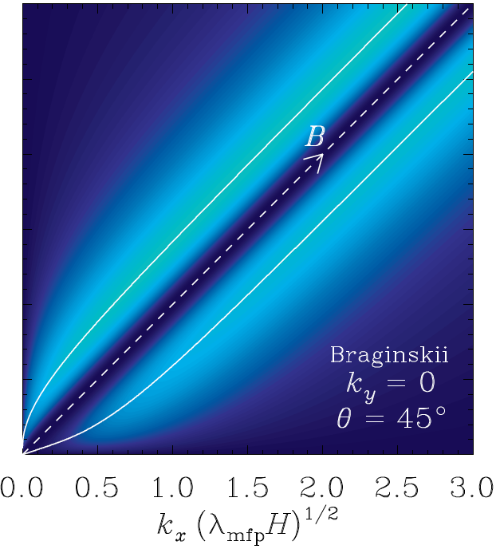
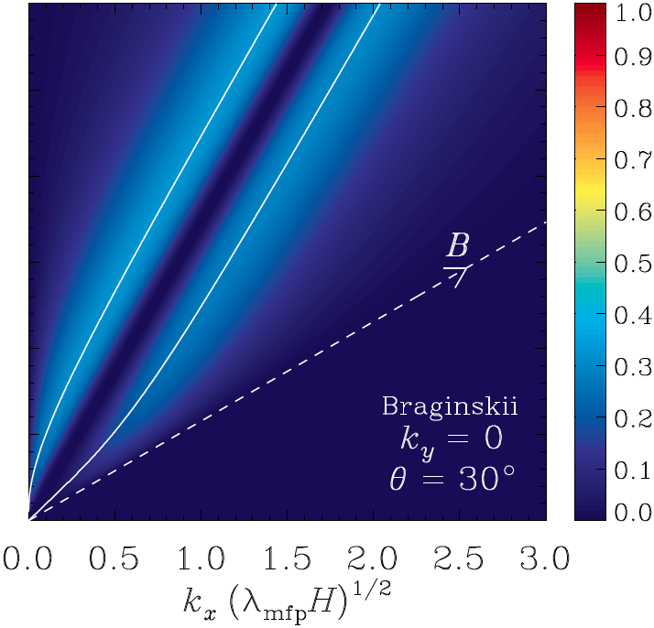

Slide 30
The situation is actually worse for 3D modes. The extra degree of freedom allows the fluid to maintain .
no Braginskii
Braginskii

Slide 31
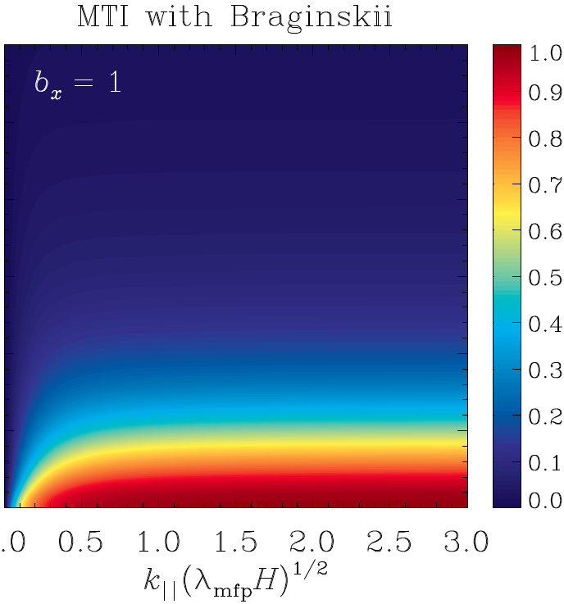
What about the MTI?

Slide 32
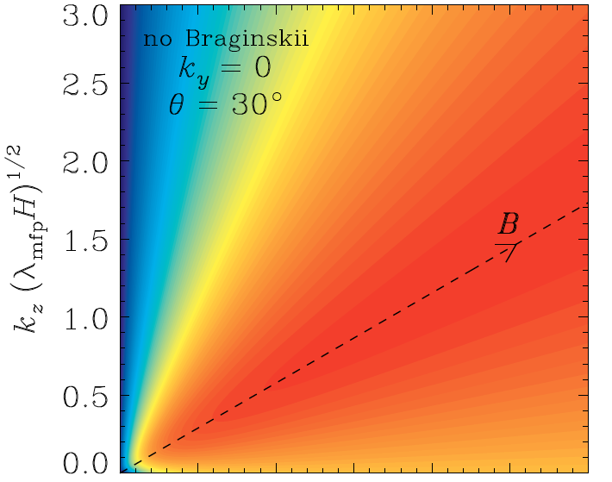
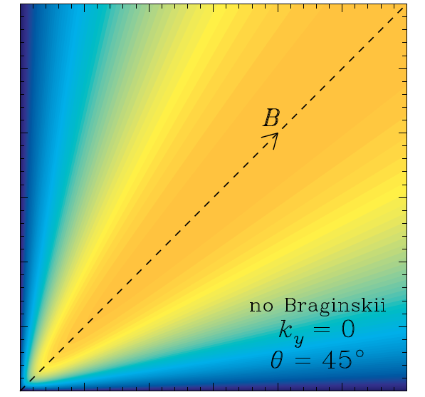
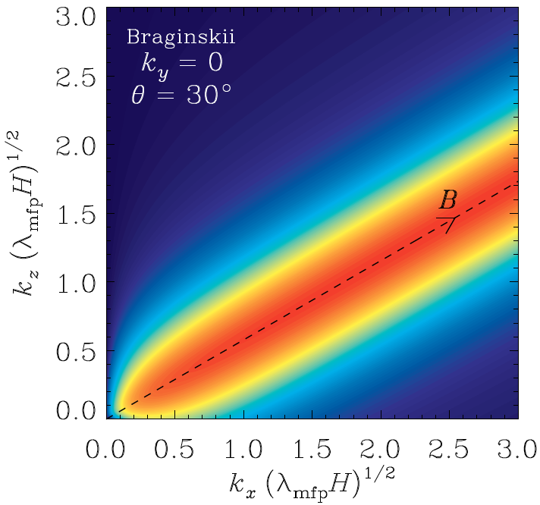
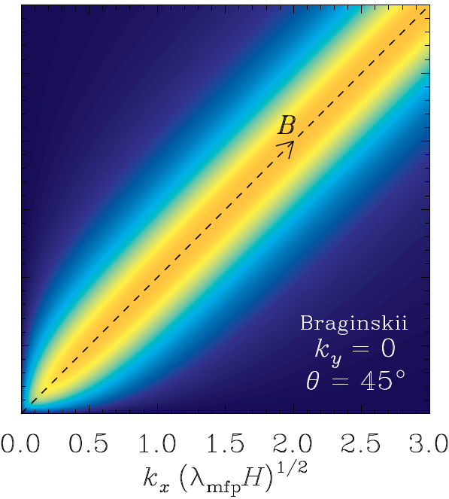
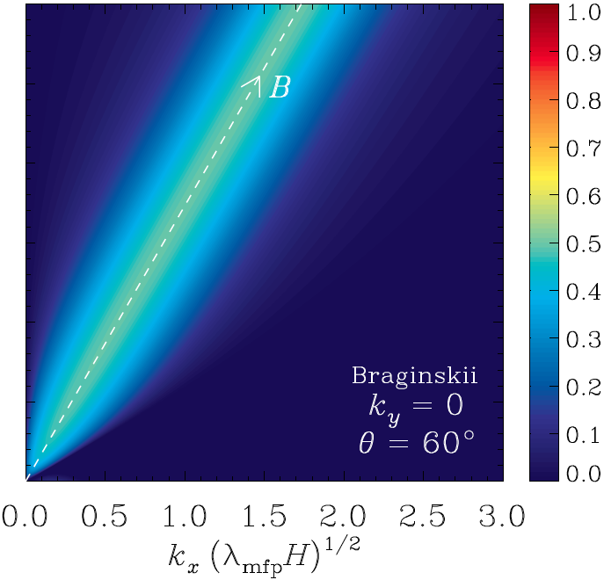

Slide 33
There’s also a whole bunch of modes that were thought to be stable or slow-growing that actually grow at the maximum rate. Let’s look at the (approx.) dispersion relation…

Slide 34
0 if k_{y} b_{x} = 0
Alfven mode
Braginskii damping of slow mode
cause of MTI/HBI
coupling of Alfven and slow modes
slow mode
modes are decoupled
When , > 0 Just a little bit of k_{y} will make these maximally unstable!

Slide 35
(stable)

Slide 36
(unstable)

Slide 37
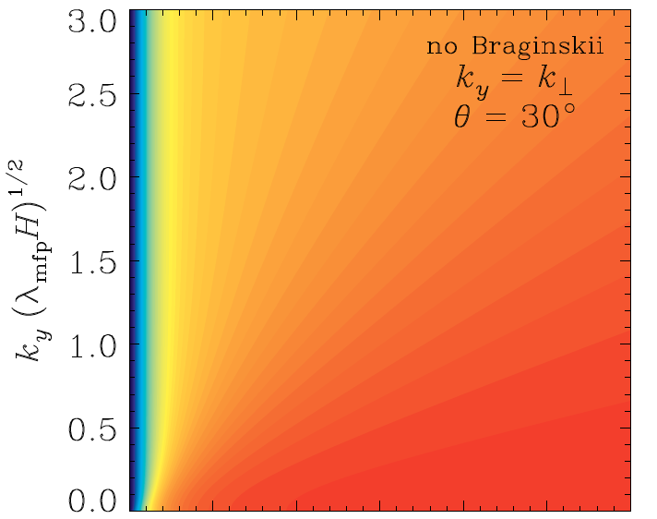
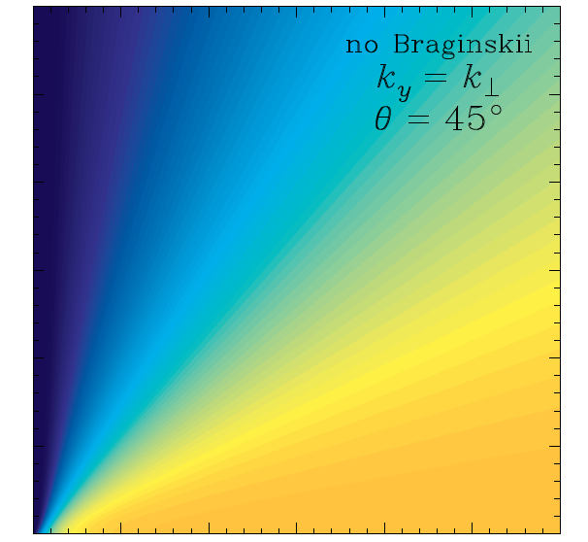
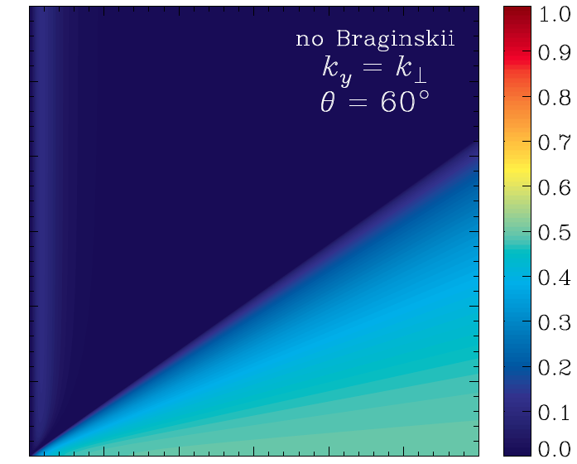
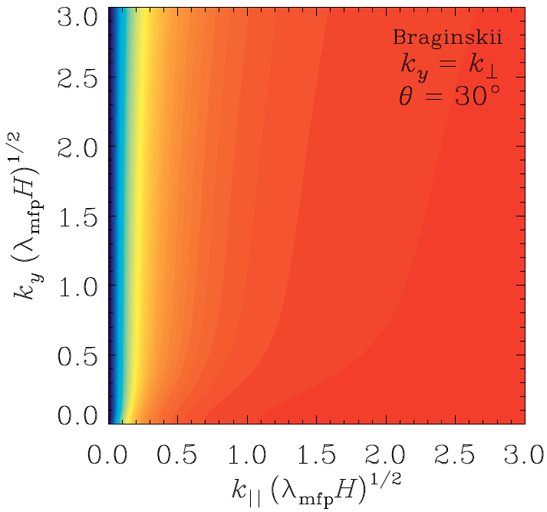
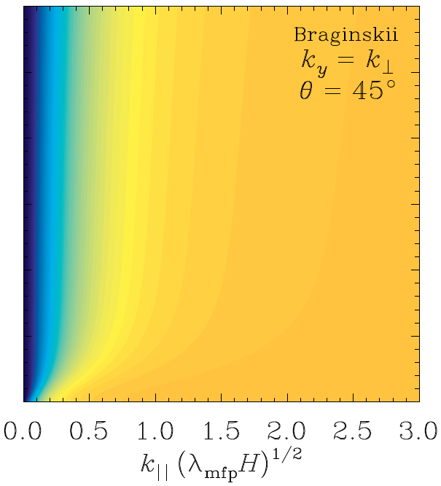
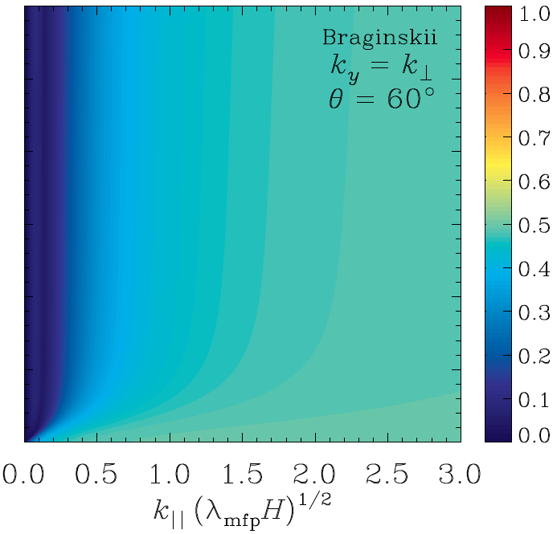
stable

Slide 38
Second Question: If pressure anisotropy grows to ~1/ , very fast microscale instabilities are triggered. What does this imply for nonlinear stability of ICM?

Slide 39
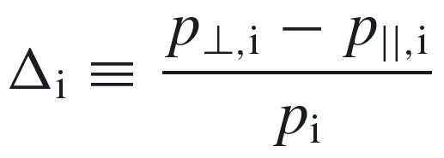
Magnetic field decreases: Δ<0
FIREHOSE:
destabilised Alfvén wave
Magnetic field increases: Δ>0
MIRROR:
kinetic resonant instability

Slide 40
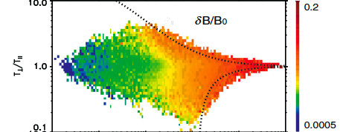
Instabilities saturate by driving Δ ~ 1/
strong evidence in solar wind:
[Bale et al., PRL 2009]
MIRROR
FIREHOSE
(colour represents magnitude of magnetic fluctuations)

Slide 41
no pitch-angle scattering
fudge factor ~1
compare to radiative cooling:

Slide 42
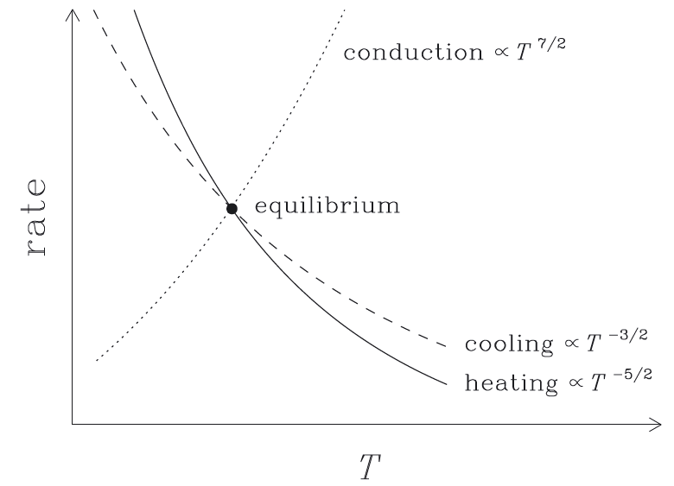
This heating mechanism is thermally stable!
See Kunz et al. (2011, MNRAS, 410, 2446) for details

Slide 43
Conclusions & Speculations
Low degree of collisionality in ICM leads to anisotropic heat and momentum transport. These affect ICM’s stability.
ICM is unstable to buoyancy instabilities driven by anisotropic conduction (HBI, MTI), but these are significantly modified by pressure anisotropy (i.e. anisotropic viscosity). Pressure anisotropy generated when , implies perturbations with are damped. Bad for HBI, good for MTI.
Since high k|| modes are suppressed, fastest growing HBI modes aren’t what we thought they were – they’re not really local either. Also, many previously-thought stable or slow-growing MTI modes are actually unstable.
Field-line insulation via HBI was made possible by fast growth rates for large k|| modes. Since this is suppressed, field-line insulation isn’t a problem?
Nonlinear evolution of MTI probably more vigorous than previously thought, since there isn’t just one dominant mode anymore.
Nonlinearly, pressure anisotropy limited by ~1/ . Provides a source of thermally-stable heating comparable to radiative cooling for typical cool-core conditions. If enough turbulent energy, then .

Slide 44
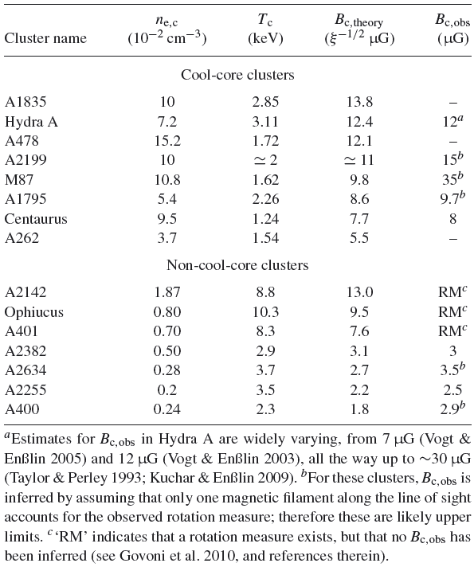

Slide 45
